Slide 1
Social Media and Web Analytics
Measurement

Slide 2
Blake et al. – eBay Advertisements
Task: Measure the impact of paid search ads on traffic and attributed sales
Implementation:
Ran a series of controlled experiments for eBay on their paid search campaigns
Finding:
No significant impact of paid search ads on branded and non-branded keywords
Paid search made an impact only on new customers

Slide 3
Blake et al. – eBay Advertisements
Why run experiments in this case?
Location of customers on the CDJ and their use of SEM
Branded keywords vs non-branded keywords
How can these differences be accounted for?

Slide 4
Blake et al. – eBay Advertisements
Step 1: Run an experiment (also known as A/B testing by people who believe the world was created when computers were invented)
You will need a treatment group and a control group
It is important to get the right “control” group. The only difference between the groups must be the “treatment”
How practical is this in reality?
Ebay experiments: Branded Keywords
Treatment Group
Control Group
Paid Search Ads on Google
Paid Search Ads on Microsoft and Yahoo!
Are these two groups the same?

Slide 5
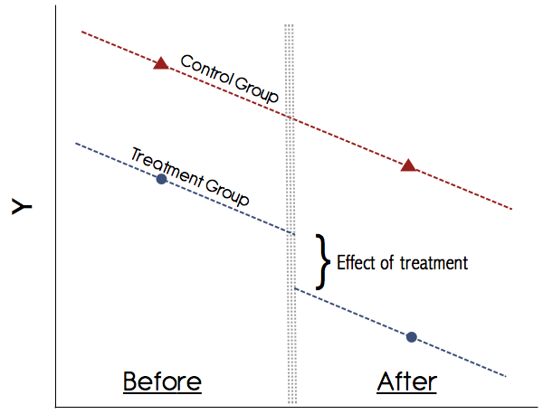
The strategy in this paper - Difference in difference (DID)
Statistical technique used to capture an experimental like setup using observational data
Captures changes in outcome over time between a treatment group and control group
Key requirements
Panel data (requires data before the intervention time period for both treatment and control)
Parallel Trends assumption: Absent the intervention, both treatment and control will be parallel to each other (constant difference)
Other assumptions are also there but the two above are most important.

Slide 6
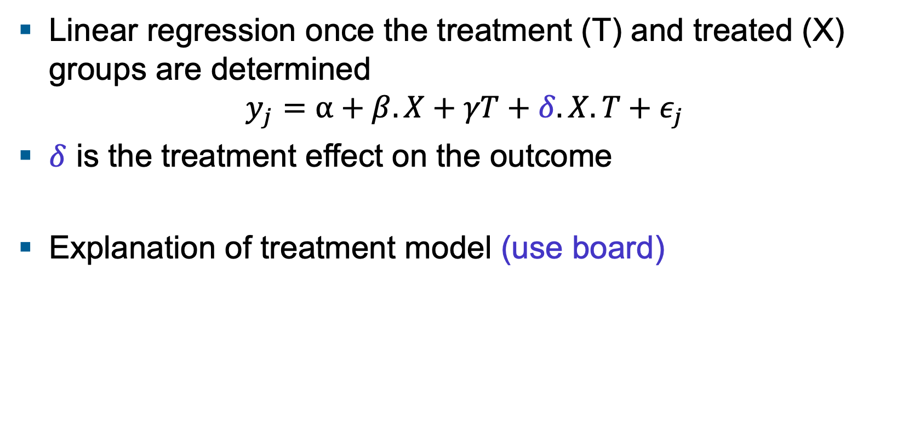
How do you calculate these effects?
Linear regression once the treatment (T) and treated (X) groups are determined
$$y_{j}=α+β.X+γT+δ.X.T+ε_{j}$$
$δ$ is the treatment effect on the outcome
Explanation of treatment model (use board)

Slide 7
Exercise
The data is from a hypothetical restaurant review company in India whose primary source of income is from advertising (ecommercedataset.xlsx)
The ads run by the company are shown above google ads.
To find effectiveness, the group is experimenting with two different advertising packages (treatment 1 – current algorithm and treatment 2 – new algorithm) while the control group has no advertisements
Identify which advertising package works best?
Do both advertising packages work similarly for all restaurant types?

Slide 8
Star digital – Assessing the Effectiveness of display Advertising
Is Online Advertising effective for Star Digital?
Is there a frequency effect of advertising on purchase?
Where should they advertise?
Why experiments? Are there other ways to achieve this?
What is the criterion for setting this up?

Slide 9
Key takeaways
Is Online Advertising effective for Star Digital?
Exposure to online advertising increases the odds of purchase by 0.019 or 1.9% (using RegModel 1)
Is there a frequency effect of advertising on purchase?
Yes. When test subjects were exposed to more number of impressions, the odds of purchase went up by 0.001 or 0.1% (RegModel 7)
Where should they advertise?
Ad channels 1-5; leads to a Profit of $935 per 1000 impressions while Ad channel 6 leads to 0 conversions (if you use significance)
Ad Channel 6 (if you don’t use significance) as it leads to $1660 in profits per 1000 impressions

Slide 10
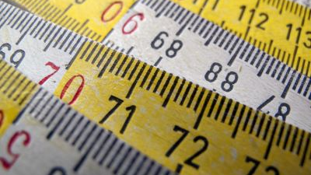
Measurement
Attribution modeling

Slide 11
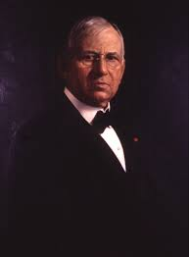
Half the money I spend on advertising is wasted. Problem is I don’t know which half..
John Wannamaker

Slide 12
Steps to calculate ROI of digital marketing
Prepare and organize your data
Decide on touchpoints, outcomes and rules for calculating ROI
Experiment
Play with multiple levers to figure out the best combination for you
Apply statistical analysis
Regressions
Get creative (statistical power or experiments)
Incremental value
Bayesian

Slide 13
Attribution models
Last click models
Last ad or click accounts for 100% of sale
First click models
Last ad or click accounts for 100% of sale
Position models
Ads get attribution based on position in path
Time Decay models
All ads or click get some attribution, more recent ads get a higher weight
Equal spend (linear) models
All ads or click get a uniform weight
Regression or Model based
Attributions weight based on regression or other model approaches
Multichannel attribution models

Slide 14
Group Exercise
Refer to excel worksheet provided

Slide 15


New innovations in attribution modeling
Incremental value: Assessing the value of different channels by experimentation
Ghost Ads:
Identifying the right control group and obtaining the right metric

Slide 16
Classes can open the doors to the future, but you must enter it yourself..
Chinese proverb
Thank you

Slide 18




Stay in touch
Madhu-Viswanathan: www.linkedin.com/in/madhu-viswanathan
DSMM page @ISBDSMM ; personal profile - beerball
@beerbawl
@DSMMISB @beerball

Slide 19
Optional Exercise
Social Media Ad Campaign marketing is a leading source of Sales Conversion
The data provided can be used for finding the relationships between campaigns and social media advertising.
Using the data provided please do the following
Identify the relationship between impressions and conversions?
How do consumer demographics affect this relationship?

